Slide 1
Chapter 6
Basic SQL

Slide 2
- SQL Data Definition and Data Types
- Specifying Constraints in SQL
- Basic Retrieval Queries in SQL
- INSERT, DELETE, and UPDATE Statements in SQL
- Additional Features of SQL
Content

Slide 3
Introduction about SQL
SQL: Structured Query Language.
Originally, SQL was called SEQUEL (Structured English QUEry Language) and was designed and implemented at IBM Research as the interface for an experimental relational database system called SYSTEM R.
SQL is now the standard language for commercial relational DBMSs.
SQL is a comprehensive database language: It has statements for data definitions, queries, and updates. Hence, it is both a DDL and a DML.
It has facilities for defining views on the database, for specifying security and authorization, for defining integrity constraints, and for specifying transaction controls.

Slide 4
SQL Data Definition and Data Types
SQL uses the terms table, row, and column for the formal relational model terms relation, tuple, and attribute.
The main SQL command for data definition is the CREATE statement, which can be used to
  create schemas,
  tables (relations),
  domains,
  views,
  and triggers.

Slide 5
SQL Data Definition and Data Types
Schema and Catalog Concepts in SQL
An SQL schema is identified by a schema name and includes an authorization identifier to indicate the user or account who owns the schema, as well as descriptors for each element in the schema.
Schema elements include tables, constraints, views, domains, and other constructs (such as authorization grants) that describe the schema.
A schema is created via the CREATE SCHEMA statement, which can include all the schema elements’ definitions.
For example, the following statement creates a schema called “COMPANY” owned by the user with authorization identifier ‘Jsmith’.
CREATE SCHEMA COMPANY AUTHORIZATION Jsmith;

Slide 6
SQL Data Definition and Data Types
Schema and Catalog Concepts in SQL
In addition to the concept of a schema, SQL uses the concept of a catalog—a named collection of schemas.
A catalog always contains a special schema called INFORMATION_SCHEMA, which provides information on all the schemas in the catalog and all the element descriptors in these schemas.

Slide 7
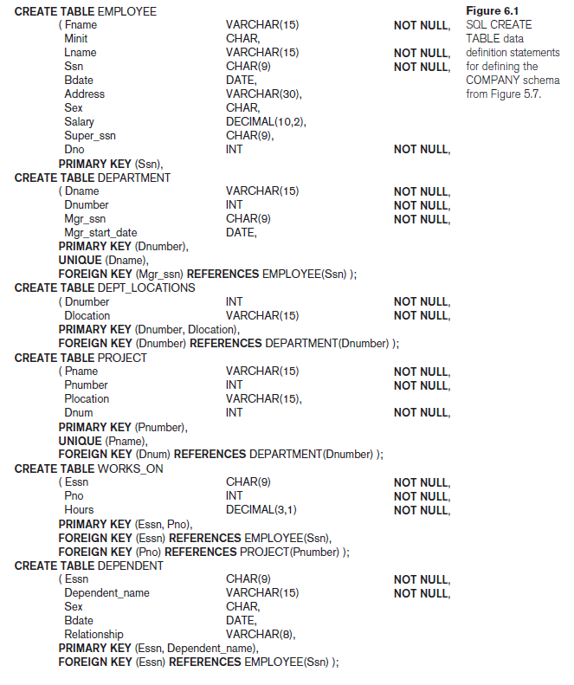
SQL Data Definition and Data Types
The CREATE TABLE Command in SQL
The CREATE TABLE command is used to specify a new relation by giving it a name and specifying its attributes and initial constraints.
The attributes are specified first, and each attribute is given a name, a data type to specify its domain of values, and possibly attribute constraints, such as NOT NULL.
The key, entity integrity, and referential integrity constraints can be specified within the CREATE TABLE statement after the attributes are declared, or they can be added later using the ALTER TABLE command.
Figure 6.1 shows sample data definition statements in SQL for the COMPANY relational database schema.

Slide 8
SQL Data Definition and Data Types
The CREATE TABLE Command in SQL
The relations declared through CREATE TABLE statements are called base tables (or base relations) this means that the table and its rows are actually created and stored as a file by the DBMS.
Base relations are distinguished from virtual relations, created through the CREATE VIEW statement, which may or may not correspond to an actual physical file.
In SQL, the attributes in a base table are considered to be ordered in the sequence in which they are specified in the CREATE TABLE statement. However, rows (tuples) are not considered to be ordered within a table (relation).
It is important to note that in Figure 6.1, there are some foreign keys that may cause errors because they are specified either via circular references or because they refer to a table that has not yet been created.
  For example, the foreign key Super_ssn in the EMPLOYEE table is a circular reference because it refers to the EMPLOYEE table itself. The foreign key Dno in the EMPLOYEE table refers to the DEPARTMENT table, which has not been created yet.
  To deal with this type of problem, these constraints can be left out of the initial CREATE TABLE statement, and then added later using the ALTER TABLE statement

Slide 9
SQL Data Definition and Data Types
Attribute Data Types and Domains in SQL
The basic data types available for attributes include numeric, character string, bit string, Boolean, date, and time.
Numeric data types include integer numbers of various sizes (INTEGER or INT, and SMALLINT) and floating-point (real) numbers of various precision (FLOAT or REAL, and DOUBLE PRECISION). Formatted numbers can be declared by using DECIMAL(i, j)—or DEC(i, j) where i, the precision, is the total number of decimal digits and j, the scale, is the number of digits after the decimal point.
Character-string data types are either fixed length—CHAR(n) or CHARACTER(n), where n is the number of characters—or varying length— VARCHAR(n) or CHAR VARYING(n) or CHARACTER VARYING(n), where n is the maximum number of characters. When specifying a literal string value, it is placed between single quotation marks (apostrophes), and it is case sensitive.
  Concatenation operator denoted by || (double vertical bar) that can concatenate two strings.
Bit-string data types are either of fixed length n—BIT(n)—or varying length— BIT VARYING(n), where n is the maximum number of bits. The default for n, the length of a character string or bit string, is 1.
  BINARY LARGE OBJECT or BLOB is also available to specify columns that have large binary values, such as images.

Slide 10
SQL Data Definition and Data Types
Attribute Data Types and Domains in SQL
A Boolean data type has the traditional values of TRUE or FALSE. In SQL, because of the presence of NULL values, a three-valued logic is used, so a third possible value for a Boolean data type is UNKNOWN.
The DATE data type has ten positions, and its components are YEAR, MONTH, and DAY in the form YYYY-MM-DD. The TIME data type has at least eight positions, with the components HOUR, MINUTE, and SECOND in the form HH:MM:SS.
A timestamp data type (TIMESTAMP) includes the DATE and TIME fields, plus a minimum of six positions for decimal fractions of seconds and an optional WITH TIME ZONE qualifier.
Domain can be declared, and the domain name can be used with the attribute specification.
  For example, we can create a domain SSN_TYPE by the following statement: CREATE DOMAIN SSN_TYPE AS CHAR(9);
  This makes it easier to change the data type for a domain that is used by numerous attributes in a schema

Slide 11
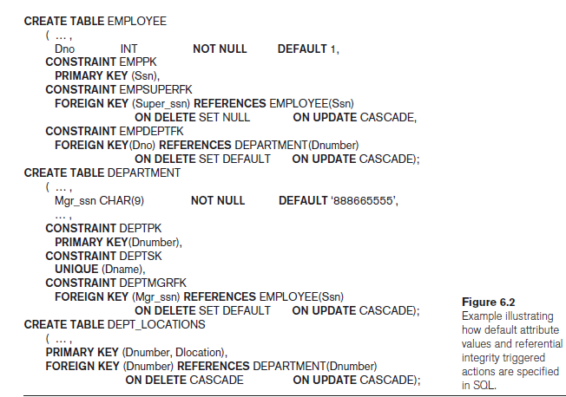
Specifying Constraints in SQL
Specifying Attribute Constraints and Attribute Defaults
Because SQL allows NULLs as attribute values, a constraint NOT NULL may be specified if NULL is not permitted for a particular attribute.
It is also possible to define a default value for an attribute by appending the clause DEFAULT <value> to an attribute definition. The default value is included in any new tuple if an explicit value is not provided for that attribute.
Figure 6.2 illustrates an example of specifying a default manager for a new department and a default department for a new employee.
If no default clause is specified, the default value is NULL for attributes that do not have the NOT NULL constraint.

Slide 12
Specifying Constraints in SQL
Specifying Attribute Constraints and Attribute Defaults
Another type of constraint can restrict attribute or domain values using the CHECK clause following an attribute or domain definition.
For example, suppose that department numbers are restricted to integer numbers between 1 and 20; then, we can change the attribute declaration of Dnumber in the DEPARTMENT table.
Dnumber INT NOT NULL CHECK (Dnumber > 0 AND Dnumber < 21);
The CHECK clause can also be used in conjunction with the CREATE DOMAIN statement.
For example, we can write the following statement:
CREATE DOMAIN D_NUM AS INTEGER
CHECK (D_NUM > 0 AND D_NUM < 21);

Slide 13
Specifying Constraints in SQL
Specifying Key and Referential Integrity Constraints
The PRIMARY KEY clause specifies one or more attributes that make up the primary key of a relation.
If a primary key has a single attribute, the clause can follow the attribute directly. For example, the primary key of DEPARTMENT can be specified as follows: Dnumber INT PRIMARY KEY.
The UNIQUE clause specifies alternate (unique) keys, also known as candidate keys.
The UNIQUE clause can also be specified directly for a unique key if it is a single attribute, as in the following example: Dname VARCHAR(15) UNIQUE.
Schema designer can specify an alternative action to be taken by attaching a referential triggered action clause to any foreign key constraint. The options include SET NULL, CASCADE, and SET DEFAULT. An option must be qualified with either ON DELETE or ON UPDATE.

Slide 14
Specifying Constraints in SQL
Giving Names to Constraints
A constraint may be given a constraint name, following the keyword CONSTRAINT.
The names of all constraints within a particular schema must be unique.
A constraint name is used to identify a particular constraint in case the constraint must be dropped later and replaced with another constraint.

Slide 15
Specifying Constraints in SQL
Specifying Constraints on Tuples Using CHECK
Table constraints can be specified through additional CHECK clauses at the end of a CREATE TABLE statement.
These can be called row-based constraints because they apply to each row individually and are checked whenever a row is inserted or modified.
For example, suppose that the DEPARTMENT table in Figure 6.1 had an additional attribute Dept_create_date, which stores the date when the department was created.
Then we could add the following CHECK clause at the end of the CREATE TABLE statement for the DEPARTMENT table to make sure that a manager’s start date is later than the department creation date.
CHECK (Dept_create_date <= Mgr_start_date);

Slide 16
Basic Retrieval Queries in SQL
The SELECT-FROM-WHERE Structure of Basic SQL Queries
The basic form of the SELECT statement, sometimes called a mapping or a select-from-where block, is formed of the three clauses SELECT, FROM, and WHERE and has the following form:
SELECT <attribute list>
FROM <table list>
WHERE <condition>;
where
  <attribute list> is a list of attribute names whose values are to be retrieved by the query.
  <table list> is a list of the relation names required to process the query.
  <condition> is a conditional (Boolean) expression that identifies the tuples to be retrieved by the query.

Slide 17
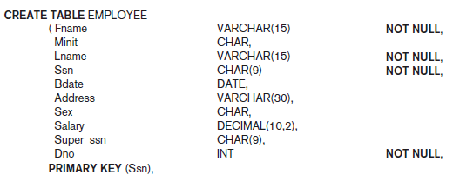
Basic Retrieval Queries in SQL
The SELECT-FROM-WHERE Structure of Basic SQL Queries
The SELECT clause of SQL specifies the attributes whose values are to be retrieved, which are called the projection attributes in relational algebra
and the WHERE clause specifies the Boolean condition that must be true for any retrieved tuple, which is known as the selection condition in relational algebra.
Query 0. Retrieve the birth date and address of the employee(s) whose name is ‘John B. Smith’.

Slide 18

Basic Retrieval Queries in SQL
Query 0. Retrieve the birth date and address of the employee(s) whose name is ‘John B. Smith’.
Q0: SELECT Bdate, Address
FROM EMPLOYEE
WHERE Fname = ‘John’ AND Minit = ‘B’ AND Lname = ‘Smith’;

Slide 19
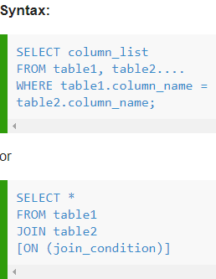
Basic Retrieval Queries in SQL
The SELECT-FROM-WHERE Structure of Basic SQL Queries
SQL EQUI JOIN performs a JOIN against equality or matching column(s) values of the associated tables.
An equal sign (=) is used as comparison operator in the where clause to refer equality.

Slide 20
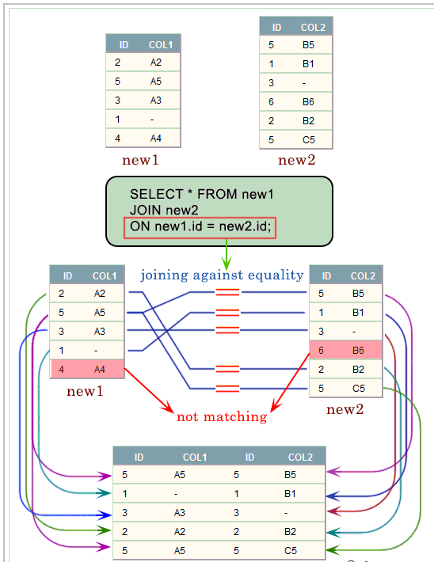
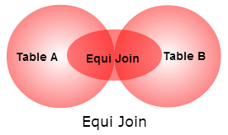
Basic Retrieval Queries in SQL
EQUIJOIN

Slide 21
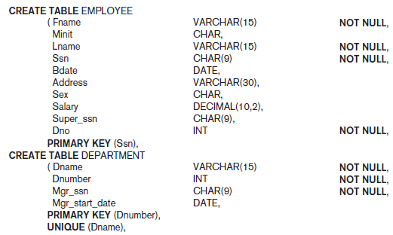
Basic Retrieval Queries in SQL
The SELECT-FROM-WHERE Structure of Basic SQL Queries
Query 1. Retrieve the name and address of all employees who work for the ‘Research’ department.

Slide 22
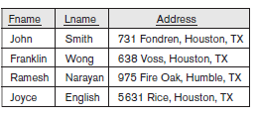
Basic Retrieval Queries in SQL
The SELECT-FROM-WHERE Structure of Basic SQL Queries
Query 1. Retrieve the name and address of all employees who work for the ‘Research’ department.
Q1: SELECT Fname, Lname, Address
FROM EMPLOYEE, DEPARTMENT
WHERE Dname = ‘Research’ AND Dnumber = Dno;
In the WHERE clause of Q1, the condition Dname = ‘Research’ is a selection condition that chooses the particular tuple of interest in the DEPARTMENT table, because Dname is an attribute of DEPARTMENT.
The condition Dnumber = Dno is called a join condition, because it combines two tuples: one from DEPARTMENT and one from EMPLOYEE, whenever the value of Dnumber in DEPARTMENT is equal to the value of Dno.

Slide 23
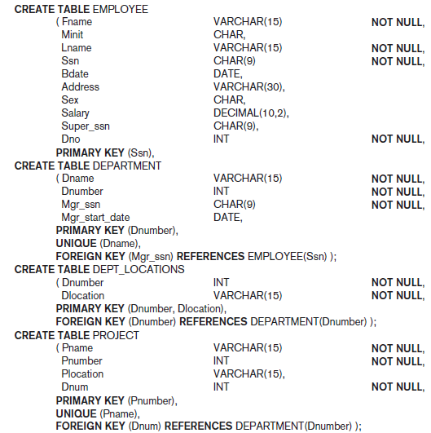
Basic Retrieval Queries in SQL
The SELECT-FROM-WHERE Structure of Basic SQL Queries
Query 2. For every project located in ‘Stafford’, list the project number, the controlling department number, and the department manager’s last name, address, and birth date.

Slide 24

Basic Retrieval Queries in SQL
The SELECT-FROM-WHERE Structure of Basic SQL Queries
Query 2. For every project located in ‘Stafford’, list the project number, the controlling department number, and the department manager’s last name, address, and birth date.
Q2: SELECT Pnumber, Dnum, Lname, Address, Bdate
FROM PROJECT, DEPARTMENT, EMPLOYEE
WHERE Dnum = Dnumber AND Mgr_ssn = Ssn AND
Plocation = ‘Stafford’
The join condition Dnum = Dnumber relates a project tuple to its controlling department tuple, whereas the join condition Mgr_ssn = Ssn relates the controlling department tuple to the employee tuple who manages that department.
Each tuple in the result will be a combination of one project, one department (that controls the project), and one employee (that manages the department).
Notes:
select Pnumber, Dnumber, Lname, Bdate, Address
from PROJECT, DEPARTMENT, EMPLOYEE
WHERE Plocation = 'Stafford' AND Dnumber = Dnum AND Mgr_ssn = Ssn

Slide 25
Basic Retrieval Queries in SQL
Ambiguous Attribute Names, Aliasing, Renaming, and Tuple Variables
In SQL, the same name can be used for two (or more) attributes as long as the attributes are in different tables.
If this is the case, and a multitable query refers to two or more attributes with the same name, we must qualify the attribute name with the relation name to prevent ambiguity.
This is done by prefixing the relation name to the attribute name and separating the two by a period.

Slide 26
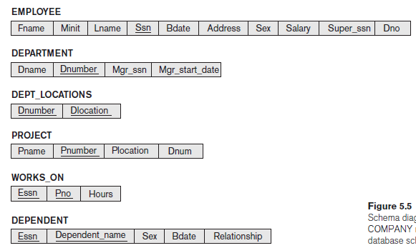
Basic Retrieval Queries in SQL
Ambiguous Attribute Names, Aliasing, Renaming, and Tuple Variables
To illustrate this, suppose that the Dno and Lname attributes of the EMPLOYEE relation were called Dnumber and Name, and the Dname attribute of DEPARTMENT was also called Name; then, to prevent ambiguity, query Q1 would be rephrased as shown in Q1A.
We must prefix the attributes Name and Dnumber in Q1A to specify which ones we are referring to, because the same attribute names are used in both relations:
Query 1. Retrieve the name and address of all employees who work for the ‘Research’ department.
Q1A: SELECT Fname, EMPLOYEE.Name, Address
FROM EMPLOYEE, DEPARTMENT
WHERE DEPARTMENT.Name = ‘Research’ AND
DEPARTMENT.Dnumber = EMPLOYEE.Dnumber;

Slide 27

Basic Retrieval Queries in SQL
Ambiguous Attribute Names, Aliasing, Renaming, and Tuple Variables
A self join is a join in which a table is joined with itself (which is also called Unary relationships), especially when the table has a FOREIGN KEY which references its own PRIMARY KEY.
To join a table itself means that each row of the table is combined with itself and with every other row of the table.
The syntax of the command for joining a table to itself is almost same as that for joining two different tables.
To distinguish the column names from one another, aliases for the actual the table name are used, since both the tables have the same name.
Table name aliases are defined in the FROM clause of the SELECT statement.

Slide 28
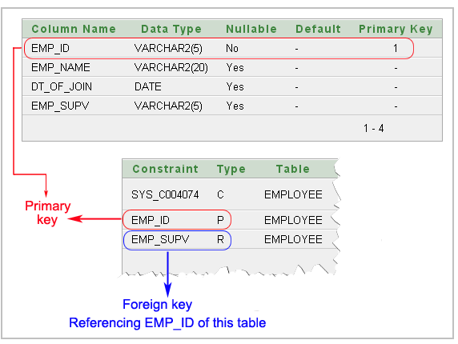
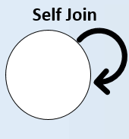
Basic Retrieval Queries in SQL
SELF JOIN

Slide 29
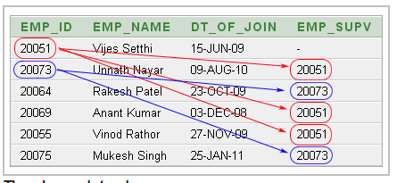
Basic Retrieval Queries in SQL
SELF JOIN
The above data shows:
Unnath Nayar's supervisor is Vijes Setthi
Anant Kumar and Vinod Rathor can also report to Vijes Setthi.
Rakesh Patel and Mukesh Singh are under supervison of Unnith Nayar.

Slide 30

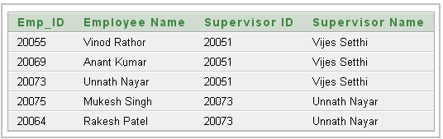
Basic Retrieval Queries in SQL
SELF JOIN

Slide 31
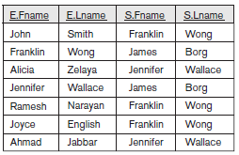
Basic Retrieval Queries in SQL
Ambiguous Attribute Names, Aliasing, Renaming, and Tuple Variables
We can also rename the table names to shorter names by creating an alias for each table name to avoid repeated typing of long table names.
Query 8. For each employee, retrieve the employee’s first and last name and the first and last name of his or her immediate supervisor.
Q8: SELECT E.Fname, E.Lname, S.Fname, S.Lname
FROM EMPLOYEE AS E, EMPLOYEE AS S
WHERE E.Super_ssn = S.Ssn;
We can declare alternative relation names E and S, called aliases or tuple variables, for the EMPLOYEE relation. An alias can follow the keyword AS, as shown in Q8, or it can directly follow the relation name—for example, by writing EMPLOYEE E, EMPLOYEE S in the FROM clause of Q8.
It is also possible to rename the relation attributes within the query in SQL by giving them aliases.
For example, if we write EMPLOYEE AS E(Fn, Mi, Ln, Ssn, Bd, Addr, Sex, Sal, Sssn, Dno) in the FROM clause, Fn becomes an alias for Fname, Mi for Minit, Ln for Lname, and so on.

Slide 32
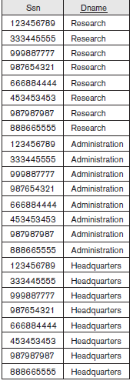
Basic Retrieval Queries in SQL
Unspecified WHERE Clause and Use of the Asterisk
A missing WHERE clause indicates no condition on tuple selection; hence, all tuples of the relation specified in the FROM clause qualify and are selected for the query result.
If more than one relation is specified in the FROM clause and there is no WHERE clause, then the CROSS PRODUCT—all possible tuple combinations—of these relations is selected.
Queries 9 and 10. Select all EMPLOYEE Ssns (Q9) and all combinations of EMPLOYEE Ssn and DEPARTMENT Dname (Q10) in the database.
Q9: SELECT Ssn
FROM EMPLOYEE;
Q10: SELECT Ssn, Dname
FROM EMPLOYEE, DEPARTMENT;

Slide 33
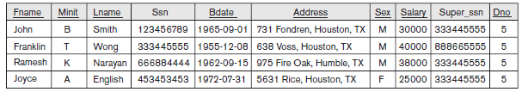
Basic Retrieval Queries in SQL
Unspecified WHERE Clause and Use of the Asterisk
To retrieve all the attribute values of the selected tuples, we do not have to list the attribute names explicitly in SQL; we just specify an asterisk (*), which stands for all the attributes.
Query Q1C retrieves all the attribute values of any EMPLOYEE who works in DEPARTMENT number 5 (Figure 6.3(g)), query Q1D retrieves all the attributes of an EMPLOYEE and the attributes of the DEPARTMENT in which he or she works for every employee of the ‘Research’ department, and Q10A specifies the CROSS PRODUCT of the EMPLOYEE and DEPARTMENT relations.
Q1C: SELECT *
FROM EMPLOYEE
WHERE Dno = 5;
Q1D: SELECT *
FROM EMPLOYEE, DEPARTMENT
WHERE Dname = ‘Research’ AND Dno = Dnumber;
Q10A: SELECT *
FROM EMPLOYEE, DEPARTMENT;

Slide 34
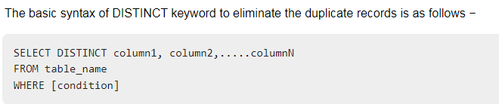
Basic Retrieval Queries in SQL
Tables as Sets in SQL
SQL usually treats a table not as a set but rather as a multiset; duplicate tuples can appear more than once in a table, and in the result of a query.
An SQL table with a key is restricted to being a set, since the key value must be distinct in each tuple.
If we do want to eliminate duplicate tuples from the result of an SQL query, we use the keyword DISTINCT in the SELECT clause, meaning that only distinct tuples should remain in the result.
In general, a query with SELECT DISTINCT eliminates duplicates, whereas a query with SELECT ALL does not. Specifying SELECT with neither ALL nor DISTINCT—as in our previous examples—is equivalent to SELECT ALL.

Slide 35
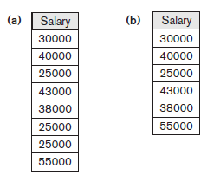
Basic Retrieval Queries in SQL
Tables as Sets in SQL
Query 11. Retrieve the salary of every employee (Q11) and all distinct salary values (Q11A).
Q11: SELECT ALL Salary
FROM EMPLOYEE;
Q11A: SELECT DISTINCT Salary
FROM EMPLOYEE;

Slide 36
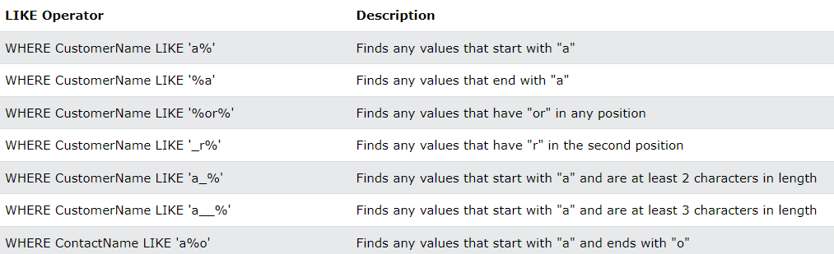
Basic Retrieval Queries in SQL
Substring Pattern Matching and Arithmetic Operators
LIKE OPERATOR
The LIKE operator is used in a WHERE clause to search for a specified pattern in a column.
There are two wildcards often used in conjunction with the LIKE operator:
  The percent sign (%) represents zero, one, or multiple characters.
  The underscore sign (_) represents one, single character.

Slide 37
Basic Retrieval Queries in SQL
Substring Pattern Matching and Arithmetic Operators
The first feature allows comparison conditions on only parts of a character string, using the LIKE comparison operator. This can be used for string pattern matching.
Partial strings are specified using two reserved characters: % replaces an arbitrary number of zero or more characters, and the underscore (_) replaces a single character. For example, consider the following query.
Query 12. Retrieve all employees whose address is in Houston, Texas.
Q12: SELECT Fname, Lname
FROM EMPLOYEE
WHERE Address LIKE ‘%Houston,TX%’;
To retrieve all employees who were born during the 1970s, we can use Query Q12A. Here, ‘7’ must be the third character of the string (according to our format for date), so we use the value ‘_ _ 7 _ _ _ _ _ _ _’, with each underscore serving as a placeholder for an arbitrary character.
Query 12A. Find all employees who were born during the 1950s.
Q12: SELECT Fname, Lname
FROM EMPLOYEE
WHERE Bdate LIKE ‘_ _ 5 _ _ _ _ _ _ _’;

Slide 38
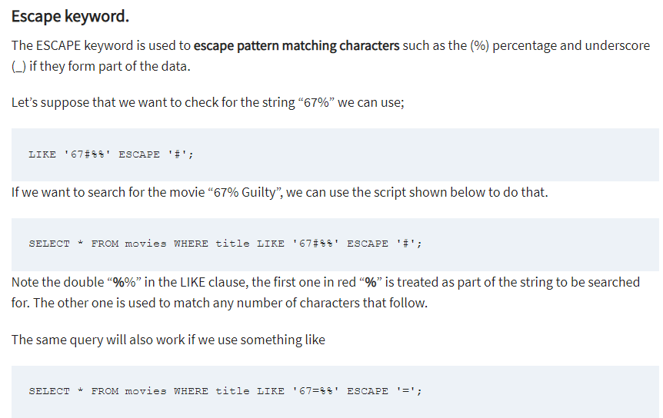
Basic Retrieval Queries in SQL
Substring Pattern Matching and Arithmetic Operators

Slide 39
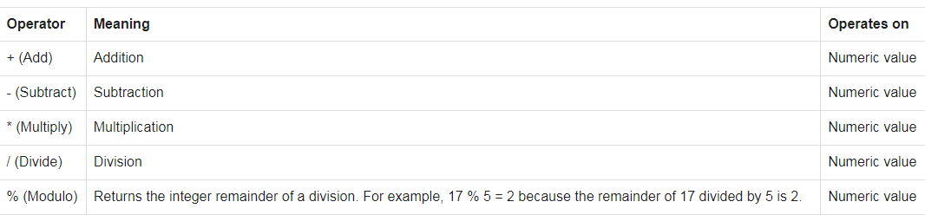
Basic Retrieval Queries in SQL
Substring Pattern Matching and Arithmetic Operators
Arithmetic Operators
Arithmetic operators are addition(+), subtraction(-), multiplication(*) and division(/).

Slide 40
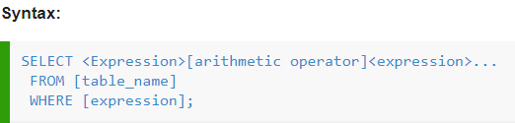
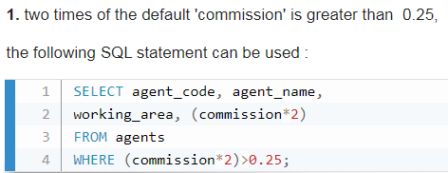
Basic Retrieval Queries in SQL
Substring Pattern Matching and Arithmetic Operators
Arithmetic Operators
Arithmetic operators are addition(+), subtraction(-), multiplication(*) and division(/).

Slide 41
Basic Retrieval Queries in SQL
Substring Pattern Matching and Arithmetic Operators
Another feature allows the use of arithmetic in queries. The standard arithmetic operators for addition (+), subtraction (−), multiplication (*), and division (/) can be applied to numeric values or attributes with numeric domains.
For example, suppose that we want to see the effect of giving all employees who work on the ‘ProductX’ project a 10% raise; we can issue Query 13 to see what their salaries would become. This example also shows how we can rename an attribute in the query result using AS in the SELECT clause.
Query 13. Show the resulting salaries if every employee working on the ‘ProductX’ project is given a 10% raise.
Q13: SELECT E.Fname, E.Lname, 1.1 * E.Salary AS Increased_sal
FROM EMPLOYEE AS E, WORKS_ON AS W, PROJECT AS P
WHERE E.Ssn = W.Essn AND W.Pno = P.Pnumber AND
P.Pname = ‘ProductX’

Slide 42
Basic Retrieval Queries in SQL
Substring Pattern Matching and Arithmetic Operators
Query 14. Retrieve all employees in department 5 whose salary is between $30,000 and $40,000.
Q14: SELECT *
FROM EMPLOYEE
WHERE (Salary BETWEEN 30000 AND 40000) AND Dno = 5;
The condition (Salary BETWEEN 30000 AND 40000) in Q14 is equivalent to the condition ((Salary >= 30000) AND (Salary <= 40000)).

Slide 43
Basic Retrieval Queries in SQL
Ordering of Query Results
SQL allows the user to order the tuples in the result of a query by the values of one or more of the attributes that appear in the query result, by using the ORDER BY clause.
Query 15. Retrieve a list of employees and the projects they are working on, ordered by department and, within each department, ordered alphabetically by last name, then first name.
Q15: SELECT D.Dname, E.Lname, E.Fname, P.Pname
FROM DEPARTMENT AS D, EMPLOYEE AS E, WORKS_ON AS W, PROJECT AS P
WHERE D.Dnumber = E.Dno AND E.Ssn = W.Essn AND W.Pno = P.Pnumber
ORDER BY D.Dname, E.Lname, E.Fname;
The default order is in ascending order of values.
We can specify the keyword DESC if we want to see the result in a descending order of values.
The keyword ASC can be used to specify ascending order explicitly.
For example, if we want descending alphabetical order on Dname and ascending order on Lname, Fname, the ORDER BY clause of Q15 can be written as:
ORDER BY D.Dname DESC, E.Lname ASC, E.Fname ASC

Slide 44
INSERT, DELETE, and UPDATE
Statements in SQL
The INSERT Command
INSERT is used to add a single tuple (row) to a relation (table).
For example, to add a new tuple to the EMPLOYEE relation shown in Figure 5.5 and specified in the CREATE TABLE EMPLOYEE … command in Figure 6.1, we can use U1:
U1: INSERT INTO EMPLOYEE
VALUES ( ‘Richard’, ‘K’, ‘Marini’, ‘653298653’, ‘1962-12-30’, ’98 Oak Forest, Katy, TX’, ‘M’, 37000, ‘653298653’, 4 );
A second form of the INSERT statement allows the user to specify explicit attribute names that correspond to the values provided in the INSERT command.
The values must include all attributes with NOT NULL specification and no default value. Attributes with NULL allowed or DEFAULT values are the ones that can be left out.
For example, to enter a tuple for a new EMPLOYEE for whom we know only the Fname, Lname, Dno, and Ssn attributes, we can use U1A:
U1A: INSERT INTO EMPLOYEE (Fname, Lname, Dno, Ssn)
VALUES (‘Richard’, ‘Marini’, 4, ‘653298653’);
Values are listed in the same order as the attributes are listed in the INSERT command itself.
It is also possible to insert into a relation multiple tuples separated by commas in a single INSERT command.

Slide 45
INSERT, DELETE, and UPDATE
Statements in SQL
The INSERT Command
A variation of the INSERT command inserts multiple tuples into a relation in conjunction with creating the relation and loading it with the result of a query. For example, to create a temporary table that has the employee last name, project name, and hours per week for each employee working on a project, we can write the statements in U3A and U3B:
U3A: CREATE TABLE WORKS_ON_INFO
( Emp_name VARCHAR(15),
Proj_name VARCHAR(15),
Hours_per_week DECIMAL(3,1) );
U3B: INSERT INTO WORKS_ON_INFO ( Emp_name, Proj_name, Hours_per_week )
SELECT E.Lname, P.Pname, W.Hours
FROM PROJECT P, WORKS_ON W, EMPLOYEE E
WHERE P.Pnumber = W.Pno AND W.Essn = E.Ssn;.

Slide 46
INSERT, DELETE, and UPDATE
Statements in SQL
The INSERT Command
Another variation for loading data is to create a new table TNEW that has the same attributes as an existing table T, and load some of the data currently in T into TNEW. The syntax for doing this uses the LIKE clause.
For example, if we want to create a table D5EMPS with a similar structure to the EMPLOYEE table and load it with the rows of employees who work in department 5, we can write the following SQL:
CREATE TABLE D5EMPS AS ( SELECT E.* FROM EMPLOYEE AS E WHERE E.Dno = 5) WITH DATA;
The clause WITH DATA specifies that the table will be created and loaded with the data specified in the query, although in some implementations it may be left out.

Slide 47
INSERT, DELETE, and UPDATE
Statements in SQL
The DELETE Command
The DELETE command removes tuples from a relation. It includes a WHERE clause, similar to that used in an SQL query, to select the tuples to be deleted.
Tuples are explicitly deleted from only one table at a time. However, the deletion may propagate to tuples in other relations if referential triggered actions are specified in the referential integrity constraints of the DDL
A missing WHERE clause specifies that all tuples in the relation are to be deleted; however, the table remains in the database as an empty table.
The DELETE commands in U4A to U4D, if applied independently to the database state shown in Figure 5.6, will delete zero, one, four, and all tuples, respectively, from the EMPLOYEE relation:
U4A: DELETE FROM EMPLOYEE
WHERE Lname = ‘Brown’;
U4B: DELETE FROM EMPLOYEE
WHERE Ssn = ‘123456789’;
U4C: DELETE FROM EMPLOYEE
WHERE Dno = 5;
U4D: DELETE FROM EMPLOYEE;

Slide 48
INSERT, DELETE, and UPDATE
Statements in SQL
The UPDATE Command
The UPDATE command is used to modify attribute values of one or more selected tuples. As in the DELETE command, a WHERE clause in the UPDATE command selects the tuples to be modified from a single relation.
However, updating a primary key value may propagate to the foreign key values of tuples in other relations if such a referential triggered action is specified in the referential integrity constraints of the DDL.
An additional SET clause in the UPDATE command specifies the attributes to be modified and their new values.
For example, to change the location and controlling department number of project number 10 to ‘Bellaire’ and 5, respectively, we use U5:
U5: UPDATE PROJECT
SET Plocation = ‘Bellaire’, Dnum = 5
WHERE Pnumber = 10;

Slide 49
Additional Features of SQL
Various techniques for specifying complex retrieval queries, including nested queries, aggregate functions, grouping, joined tables, outer joins, SQL views, triggers, and assertions; and commands for schema modification such as DROP SCHEMA.
SQL has various techniques for writing programs in various programming languages that include SQL statements to access one or more databases. These include embedded (and dynamic) SQL, SQL/CLI (Call Level Interface) and its predecessor ODBC (Open Data Base Connectivity), and SQL/PSM (Persistent Stored Modules).
Each commercial RDBMS will have, in addition to the SQL commands, a set of commands for specifying physical database design parameters, file structures for relations, and access paths such as indexes known as storage definition language (SDL).
SQL has transaction control commands. These are used to specify units of database processing for concurrency control and recovery purposes.

Slide 50
Additional Features of SQL
SQL has language constructs for specifying the granting and revoking of privileges to users. Each relation is assigned an owner, and either the owner or the DBA staff can grant to selected users the privilege to use an SQL statement—such as SELECT, INSERT, DELETE, or UPDATE. The DBA staff can grant the privileges to create schemas, tables, or views to certain users. These SQL commands—called GRANT and REVOKE.
SQL has language constructs for creating triggers. These are generally referred to as active database techniques, since they specify actions that are automatically triggered by events such as database updates.
SQL has incorporated many features from object-oriented models to have more powerful capabilities, leading to enhanced relational systems known as object-relational.
SQL and relational databases can interact with new technologies such as XML.

